Slide 1
Hosting PowerShell in a Debugger
PSExt – The bastard child of CDB and PowerShell
Staffan Gustafsson
Notes:
Name
Company
I’m going to talk about hosting PowerShell, and in particular, hosting PowerShell in one of the Windows debuggers

Slide 2
Agenda
Background
Windbg / CDB
Extensions
Hosting PowerShell
PSExt

Slide 3

But Why?!?
Crash dump analysis of deadlocks
HeartBeat thread checks for hangs
There are more than one dump
Notes:
Why anyone would do this is a good question. Working on obscure game
Public beta with crash dumps from the people playing it.
Hang 1 out of 1000h played but the hangs are caused by several different bugs
High interest in the beta
Actually one of the most successful betas in EA history with over 10 million players
determine the frequency of similar bugs

Slide 4
What is WinDbg/CDB
Debuggers that ships with the Windows SDK
Command line oriented
Very arcane
Very powerful, lots of control
Has an extension model
Has a scripting language
Notes:
Debuggers
Low footprint, optimized to be installed on a customers domain controller for remote debugging
Xcopy deployable
Command line oriented:
Visual Studio has lots of gui features that makes it really streamlined for the majority of scenarios
But if you are here, you have understood how powerful a command line interface can be, and the value of scripting
Extension model
Native exports from a dll

Slide 5
Scripting in WinDbg
$$ Get process list LIST_ENTRY in $t0. r $t0 = nt!PsActiveProcessHead $$ Iterate over all processes in list. .for (r $t1 = poi(@$t0); (@$t1 != 0) & (@$t1 != @$t0); r $t1 = poi(@$t1)) { r? $t2 = #CONTAINING_RECORD(@$t1, nt!_EPROCESS, ActiveProcessLinks); as /x Procc @$t2 $$ Get image name into $ImageName. as /ma $ImageName @@c++(&@$t2->ImageFileName[0]) .block { .echo ${$ImageName} at ${$Procc} } ad $ImageName ad Procc }
WTF

Slide 6
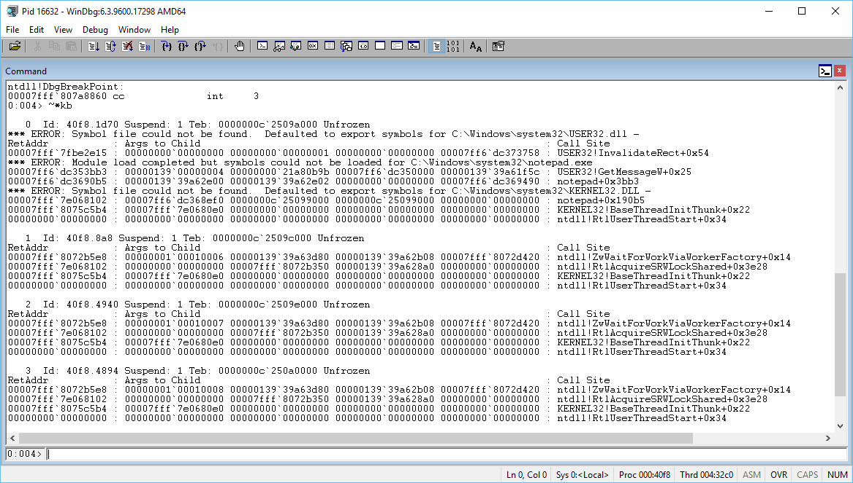
Demo of windbg/cdb

Slide 7
# good help
cdb -?
$sympath= ”$PSScriptRoot\dmp;srv*c:\sym*http://msdl.microsoft.com/download/symbols”
cdb -c '"~*k;lmv;q"' -y $sympath -n –s -lines notepad.exe
#wrapped In PowerShell
Invoke-Debugger -Command '~*k;lmv;q' –LoadSymbols`
-SymbolVerbose –Lines -Debugger windbg ` notepad.exe
Notes:
Cdbdemo.ps1

Slide 8
Extensions
A few exported functions:
HRESULT DebugExtensionInitialize(_Out_ PULONG Version, _Out_ PULONG Flags);
void CALLBACK DebugExtensionUninitialize(void);
typedef HRESULT ( CALLBACK *PDEBUG_EXTENSION_CALL)(_In_ PDEBUG_CLIENT Client, _In_opt_ PCSTR Args);
Traditionally written in C/C++
Principles of C++:
Trust the programmer.
You don't have to pay for something you don't need.
Don't break existing code.
Prefer compile time errors over run time errors.
Unmanaged Exports
Robert Giesecke
Notes:
Anyone see the fundamental flaw in this slide?

Slide 9
PSExt
PSExt uses the extension model to execute PowerShell pipelines in the debuggers.
Hosting PowerShell
Runspace
Represents the operating environment for command pipelines
PSHost
provides communications between PowerShell engine and the user

Slide 10
DbgCmdlets
DbgPSHost
System.Management. Automation
IDebugger
DebuggerProxy : IDebugger
DebuggerDispatcher
Debugger : IDebugger Symbols/Threads/Breakpoints/ Modules/Variables
Native Debugger (dbgeng.dll)

Slide 11
DbgEng
Extension
PS.InvokeAsync()
GetCallstackCommand. ProcessRecord()
!ps Get-Callstack
DispatchCalls()
Debugger.
GetCallstack()
Dispatcher
DebuggerProxy. GetCallstack()
IDebug*()
DebuggerProxy. Write(output)
DbgHost. Write(output)
IDebugControl. Output()
Debugger.
WriteLine()
Debugger thread
PowerShell thread

Slide 12
PSExt
!ps lm | where modulename -in notepad, urlmon
!ps k | ConvertTo-Json | Set-Content k.json
Notes:
Use cdb
Show
!ps k
!ps lm
!ps idc
!ps

Slide 13
PSExt – The Source
Extension
Session
Cmdlets
Proxy/Dispatcher
Debugger
Host

Slide 14
Summary
Debugger Extension
A few exported functions
PowerShell host

Slide 15
Links
Robert Giesecke – Unmanaged Exports
https://sites.google.com/site/robertgiesecke/Home/uploads/unmanagedexports
C# Wrappers for dbgeng
https://github.com/Microsoft/clrmd
PowerShell SDK Samples
https://code.msdn.microsoft.com/windowsapps/Windows-PowerShell-30-SDK-9a34641d
https://github.com/powercode/PSExt

Slide 16
Next Steps...
Now: 15 min break
Grab a coffee
Stay here to enjoy next presentation
Change track and switch to another room
Ask me questions or meet me in a breakout session room afterwards

Slide 17
Questions?

Slide 18
About_Speaker
@StaffanGson
https://github.com/powercode

